Slide 1
Strategy Pattern

Slide 2
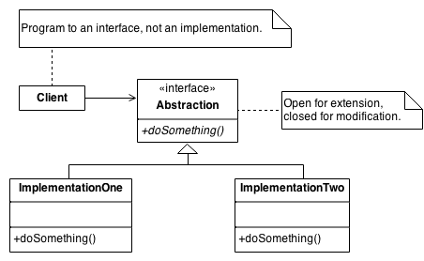
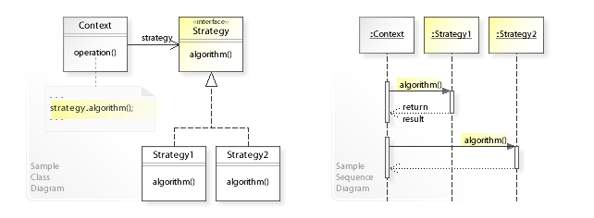
Strategy Pattern: Define a family of algorithms, encapsulate each one, and let client use them interchangeably.
Can use an Interface (not general inheritance)
Can use Templates (purists → “Template”) (compile time vs runtime)
Can use Lambdas
https://sourcemaking.com/design_patterns/strategy

Slide 3
Examples
04LecStrategy.cpp
04LecStrategyT.cpp
04LecStrategyTransportGoods.cpp
04LecStrategyTransportGoodsT.cpp
Lectures ±|master|→ g++ -S -O2 04LecStrategyTransportGoods.cpp
239 lines asm
Lectures ±|master|→ g++ -S -O2 04LecStrategyTransportGoodsT.cpp
165 lines asm

Slide 4
Strategy Pattern
Defines a family of algorithms
Encapsulated to make them interchangeable
Lets the client behavior be set or change at runtime
Textbook, Page 315-324
Duck
«interface» QuackBehavior
QuackBehavior quackBehavior
quack()
fly()
performQuack()
setQuackBehavior()
swim()
// other duck like methods
Quack
Squeak
MuteQuack
quack() { … }
quack() { … }
quack() { … }
Mallard
RubberDucky
DecoyDuck

Slide 5
Strategy Pattern
04LecStrategyTransportGoods.cpp
04LecStrategyTransportGoodsT.cpp
«interface» Insurance
getInsurancePremium()
Shipment
«interface» TransportStrategy
SafeShipment
TransportStrategy strategy
move()
transport()
getBill()
Virtual move()
//methods specific to shipping and insurance
Virtual getInsurancePremium()
Walk
Drive
Fly
move() { … }
move() { … }
move() { … }

